Slide 1
Fractional Knapsack Problem
Md. Muktar Hossain
Lecturer
Dept. of CSE
Varendra university

Slide 2
Problem Statement
Input
A knapsack with a maximum weight capacity W.
A set of n items, where each item has:
A weight w_{i}
A value v_{i}
Objective
Maximize the total value that can be carried in the knapsack without exceeding the weight W.
Unlike the 0/1 Knapsack Problem, fractions of items can be taken (i.e., items can be divided).
Constraints
1 ≤ n ≤ 10⁵ (large input sizes possible)
1 ≤ W, w_{i}, v_{i} ≤ 10⁶

Slide 3
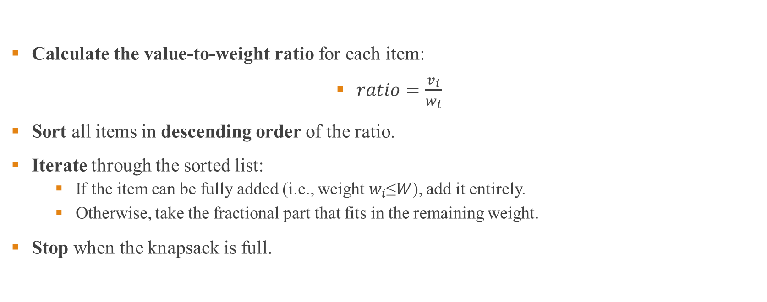
Algorithm
Calculate the value-to-weight ratio for each item:
$ratio=\frac{v_{i}}{w_{i}}$
Sort all items in descending order of the ratio.
Iterate through the sorted list:
If the item can be fully added (i.e., weight $w_{i}$≤𝑊), add it entirely.
Otherwise, take the fractional part that fits in the remaining weight.
Stop when the knapsack is full.

Slide 4
Pseudocode
Function FractionalKnapsack(W, weights[], values[], n)
1. For i = 0 to n-1:
a. Calculate ratio[i] = values[i] / weights[i]
2. Sort ratio[] in descending order.
3. Initialize totalValue = 0, currentWeight = 0.
4. For each item i in sorted ratio[]:
a. If currentWeight + weights[i] <= W:
i. Add values[i] to totalValue.
ii. Update currentWeight.
b. Else:
i. Take fraction of item: totalValue += (W - currentWeight) * ratio[i]
ii. Break loop.
5. Return totalValue.
End Function
Time Complexity
Sorting the items: O(nlog⁡n)
Iterating through items: O(n)
Overall Complexity: O(nlog⁡n)

Slide 5
Example
A knapsack is available with a maximum weight capacity of 100 kg. There are 6 items, each with a given weight and value. The goal is to maximize the total value in the knapsack without exceeding its weight capacity.
Item | Weight (kg) | Value ($)
1 | 15 | 120
2 | 35 | 300
3 | 25 | 200
4 | 50 | 500
5 | 10 | 90
6 | 30 | 400

Slide 6
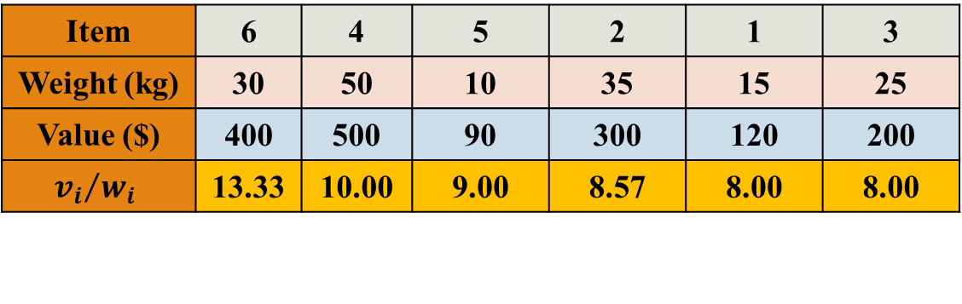
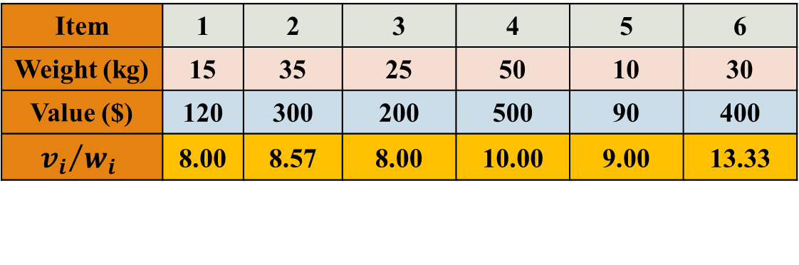
Example Cont’d
Item | 1 | 2 | 3 | 4 | 5 | 6
Weight (kg) | 15 | 35 | 25 | 50 | 10 | 30
Value ($) | 120 | 300 | 200 | 500 | 90 | 400
$${v_{i}}/{w_{i}}$$ | 8.00 | 8.57 | 8.00 | 10.00 | 9.00 | 13.33
For i = 0 to n-1:
Calculate ratio[i] = values[i] / weights[i]
Item | 6 | 4 | 5 | 2 | 1 | 3
Weight (kg) | 30 | 50 | 10 | 35 | 15 | 25
Value ($) | 400 | 500 | 90 | 300 | 120 | 200
$${v_{i}}/{w_{i}}$$ | 13.33 | 10.00 | 9.00 | 8.57 | 8.00 | 8.00
Sort ratio[] in descending order.
Initialize totalValue = 0, currentWeight = 0
totalValue = 0
currentWeight = 0

Slide 7

Example Cont’d
Item | 6 | 4 | 5 | 2 | 1 | 3
Weight (kg) | 30 | 50 | 10 | 35 | 15 | 25
Value ($) | 400 | 500 | 90 | 300 | 120 | 200
$${v_{i}}/{w_{i}}$$ | 13.33 | 10.00 | 9.00 | 8.57 | 8.00 | 8.00
For each item i in sorted ratio[]:
a. If currentWeight + weights[i] <= W:
i. Add values[i] to totalValue.
ii. Update currentWeight.
b. Else:
i. Take fraction of item:
totalValue += (W - currentWeight) * ratio[i]
ii. Break loop.
W = 100
totalValue = 0
currentWeight = 0

Slide 8
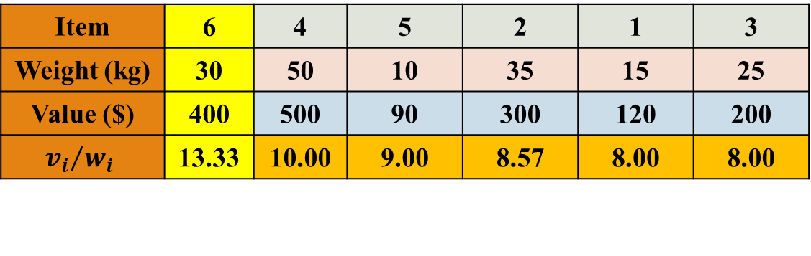
Example Cont’d
Item | 6 | 4 | 5 | 2 | 1 | 3
Weight (kg) | 30 | 50 | 10 | 35 | 15 | 25
Value ($) | 400 | 500 | 90 | 300 | 120 | 200
$${v_{i}}/{w_{i}}$$ | 13.33 | 10.00 | 9.00 | 8.57 | 8.00 | 8.00
For each item i in sorted ratio[]:
a. If currentWeight + weights[i] <= W:
i. Add values[i] to totalValue.
ii. Update currentWeight.
b. Else:
i. Take fraction of item:
totalValue += (W - currentWeight) * ratio[i]
ii. Break loop.
W = 100
totalValue = 0
currentWeight = 0

Slide 9
Example Cont’d
Item | 6 | 4 | 5 | 2 | 1 | 3
Weight (kg) | 30 | 50 | 10 | 35 | 15 | 25
Value ($) | 400 | 500 | 90 | 300 | 120 | 200
$${v_{i}}/{w_{i}}$$ | 13.33 | 10.00 | 9.00 | 8.57 | 8.00 | 8.00
For each item i in sorted ratio[]:
a. If currentWeight + weights[i] <= W:
i. Add values[i] to totalValue.
ii. Update currentWeight.
b. Else:
i. Take fraction of item:
totalValue += (W - currentWeight) * ratio[i]
ii. Break loop.
W = 100
totalValue = 400
currentWeight = 30

Slide 10
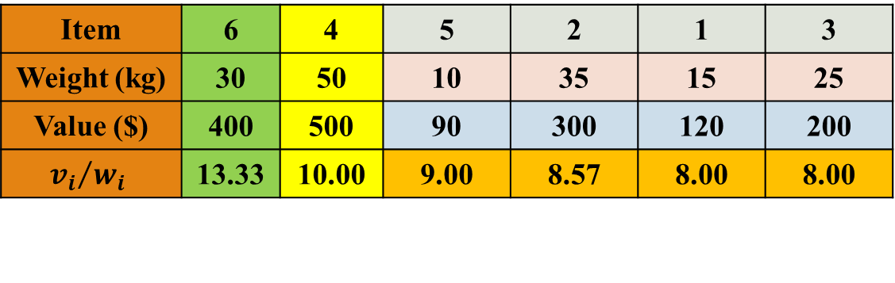
Example Cont’d
Item | 6 | 4 | 5 | 2 | 1 | 3
Weight (kg) | 30 | 50 | 10 | 35 | 15 | 25
Value ($) | 400 | 500 | 90 | 300 | 120 | 200
$${v_{i}}/{w_{i}}$$ | 13.33 | 10.00 | 9.00 | 8.57 | 8.00 | 8.00
For each item i in sorted ratio[]:
a. If currentWeight + weights[i] <= W:
i. Add values[i] to totalValue.
ii. Update currentWeight.
b. Else:
i. Take fraction of item:
totalValue += (W - currentWeight) * ratio[i]
ii. Break loop.
W = 100
totalValue = 400
currentWeight = 30

Slide 11
Example Cont’d
Item | 6 | 4 | 5 | 2 | 1 | 3
Weight (kg) | 30 | 50 | 10 | 35 | 15 | 25
Value ($) | 400 | 500 | 90 | 300 | 120 | 200
$${v_{i}}/{w_{i}}$$ | 13.33 | 10.00 | 9.00 | 8.57 | 8.00 | 8.00
For each item i in sorted ratio[]:
a. If currentWeight + weights[i] <= W:
i. Add values[i] to totalValue.
ii. Update currentWeight.
b. Else:
i. Take fraction of item:
totalValue += (W - currentWeight) * ratio[i]
ii. Break loop.
W = 100
totalValue = 900
currentWeight = 80

Slide 12
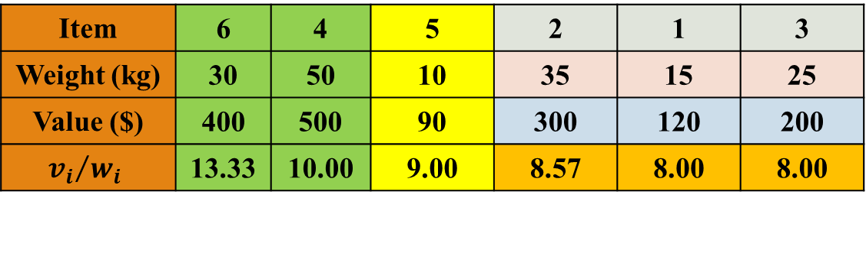
Example Cont’d
Item | 6 | 4 | 5 | 2 | 1 | 3
Weight (kg) | 30 | 50 | 10 | 35 | 15 | 25
Value ($) | 400 | 500 | 90 | 300 | 120 | 200
$${v_{i}}/{w_{i}}$$ | 13.33 | 10.00 | 9.00 | 8.57 | 8.00 | 8.00
For each item i in sorted ratio[]:
a. If currentWeight + weights[i] <= W:
i. Add values[i] to totalValue.
ii. Update currentWeight.
b. Else:
i. Take fraction of item:
totalValue += (W - currentWeight) * ratio[i]
ii. Break loop.
W = 100
totalValue = 900
currentWeight = 80

Slide 13
Example Cont’d
Item | 6 | 4 | 5 | 2 | 1 | 3
Weight (kg) | 30 | 50 | 10 | 35 | 15 | 25
Value ($) | 400 | 500 | 90 | 300 | 120 | 200
$${v_{i}}/{w_{i}}$$ | 13.33 | 10.00 | 9.00 | 8.57 | 8.00 | 8.00
For each item i in sorted ratio[]:
a. If currentWeight + weights[i] <= W:
i. Add values[i] to totalValue.
ii. Update currentWeight.
b. Else:
i. Take fraction of item:
totalValue += (W - currentWeight) * ratio[i]
ii. Break loop.
W = 100
totalValue = 990
currentWeight = 90

Slide 14
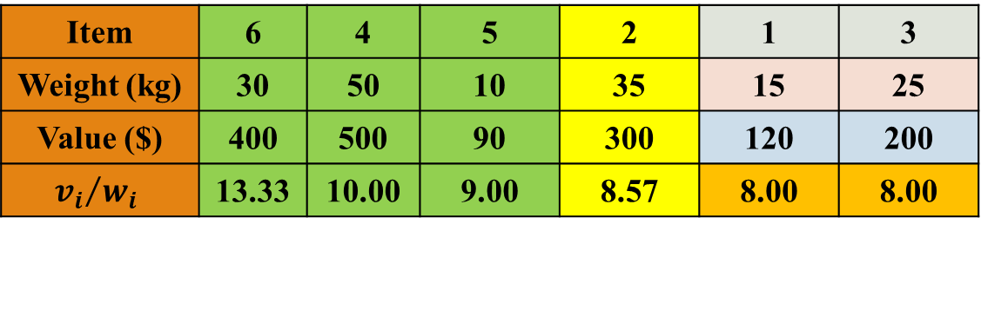
Example Cont’d
Item | 6 | 4 | 5 | 2 | 1 | 3
Weight (kg) | 30 | 50 | 10 | 35 | 15 | 25
Value ($) | 400 | 500 | 90 | 300 | 120 | 200
$${v_{i}}/{w_{i}}$$ | 13.33 | 10.00 | 9.00 | 8.57 | 8.00 | 8.00
For each item i in sorted ratio[]:
a. If currentWeight + weights[i] <= W:
i. Add values[i] to totalValue.
ii. Update currentWeight.
b. Else:
i. Take fraction of item:
totalValue += (W - currentWeight) * ratio[i]
ii. Break loop.
W = 100
totalValue = 990
currentWeight = 90

Slide 15
Example Cont’d
Item | 6 | 4 | 5 | 2 | 1 | 3
Weight (kg) | 30 | 50 | 10 | 35 | 15 | 25
Value ($) | 400 | 500 | 90 | 300 | 120 | 200
$${v_{i}}/{w_{i}}$$ | 13.33 | 10.00 | 9.00 | 8.57 | 8.00 | 8.00
For each item i in sorted ratio[]:
a. If currentWeight + weights[i] <= W:
i. Add values[i] to totalValue.
ii. Update currentWeight.
b. Else:
i. Take fraction of item:
totalValue += (W - currentWeight) * ratio[i]
ii. Break loop.
W = 100
totalValue = 1075.7
currentWeight = 90

Slide 16
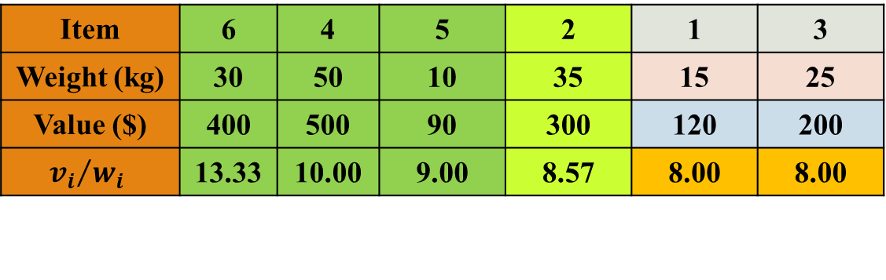
Example Cont’d
Item | 6 | 4 | 5 | 2 | 1 | 3
Weight (kg) | 30 | 50 | 10 | 35 | 15 | 25
Value ($) | 400 | 500 | 90 | 300 | 120 | 200
$${v_{i}}/{w_{i}}$$ | 13.33 | 10.00 | 9.00 | 8.57 | 8.00 | 8.00
Return totalValue.
W = 100
totalValue = 1075.7
currentWeight = 90
totalValue = 1075.7

Slide 17
Applications
Resource Allocation – Optimizing project selection, investment planning.
Cargo Loading & Logistics – Maximizing value while staying within weight limits in transport.
Manufacturing – Reducing waste in material cutting (wood, textiles, metals).
CPU Scheduling & Memory Management – Efficient job scheduling in operating systems.
Financial Portfolio Optimization – Selecting the best assets under a budget.
Network Bandwidth Allocation – Distributing bandwidth efficiently in telecommunications.
Cryptography – Used in encryption algorithms (e.g., Merkle–Hellman Knapsack Cryptosystem).
Marketing & Ads – Selecting cost-effective ads under a budget constraint.
Robotics & AI – Optimizing object carrying and path planning.
Space Exploration – Selecting scientific instruments for space missions with weight limits.

Slide 18
Thank You

